Slide 1

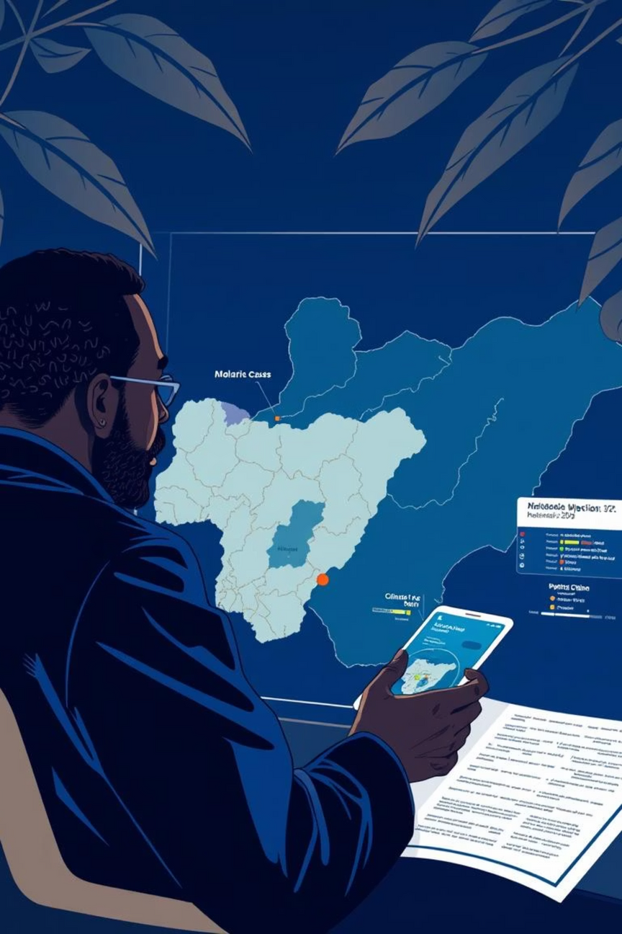
Predicting Malaria Outbreaks in Nigeria Using Climate Data and Historical Health Records
Malaria remains a leading cause of death in Nigeria. Climate factors like rainfall, temperature, and humidity significantly influence mosquito breeding. Predicting outbreaks regionally can help Nigerian health officials target resources and interventions efficiently.
Notes:
1

Slide 2
Problem Statement
“Can we predict malaria outbreaks in Nigerian regions using historical malaria case data and climate variables like temperature, rainfall, and humidity?”
Why this problem matters:
Nigeria accounts for ~27% of global malaria cases (WHO).
Regional climate variation impacts transmission patterns.
Visuals (as shown in Power BI) indicate variation in bed net usage, water sources, and electricity, which correlate with risk and preparedness.
Early predictions can reduce deaths and health system pressure.
Notes:
2

Slide 3



Key Objectives
Identify regional correlations between climate and malaria cases.
Build a predictive model to forecast high-risk periods.
Create an interactive dashboard for public health decision-makers in Nigeria.
Notes:
3

Slide 4
Dataset Identification
Malaria Dataset:
Climate Dataset:
Source: World Bank Microdata – Nigeria Malaria Indicator Survey 2021
Source: World Bank Climate Knowledge Portal – Nigeria
Type: Structured (CSV)
Variables: Monthly rainfall (mm), temperature (°C), humidity (%)
Variables: Region/State, Bed net usage, Water source, Electricity, etc.
Regionally disaggregated over years
Status: Requires cleaning and integration
Status: Clean, ready for integration
Notes:
4

Slide 5
Justification for Dataset Selection
Relevance
Merge Potential
Nigeria-specific, aligned with project goals
Data can be merged on region + month/year
Rich Features
Insightful Visuals
Allows exploration of climate, infrastructure, and health access
Power BI dashboards highlight patterns in water access, bed nets, etc.
Notes:
5

Slide 6
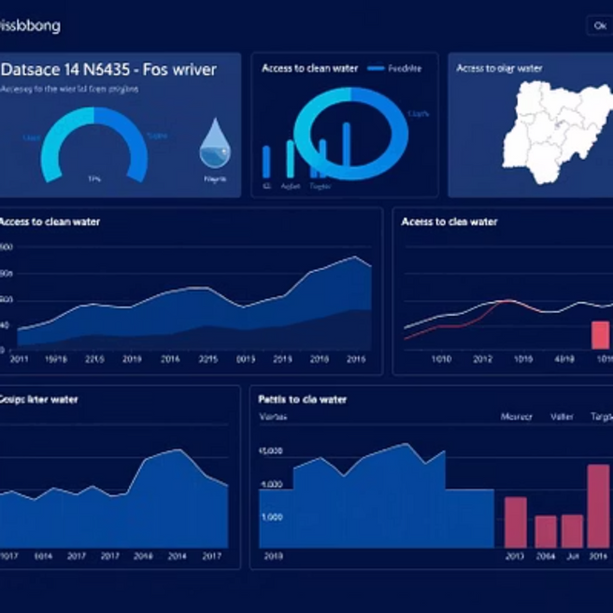
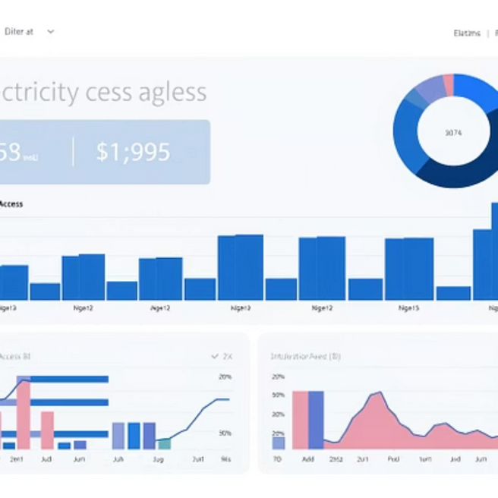
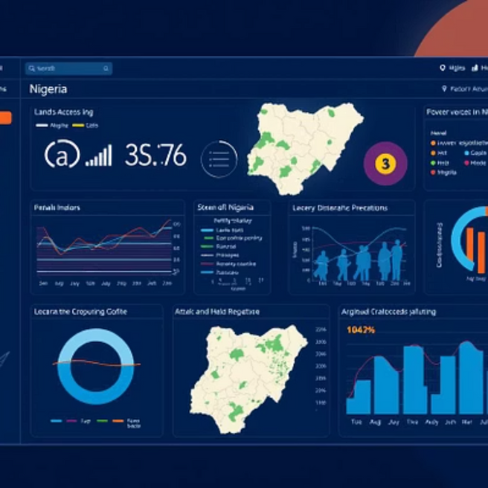
Power BI Chart Highlights to Reference
Github link: https://github.com/Fatime-Dadi/Malaria_25858
Notes:
6

